Slide 1
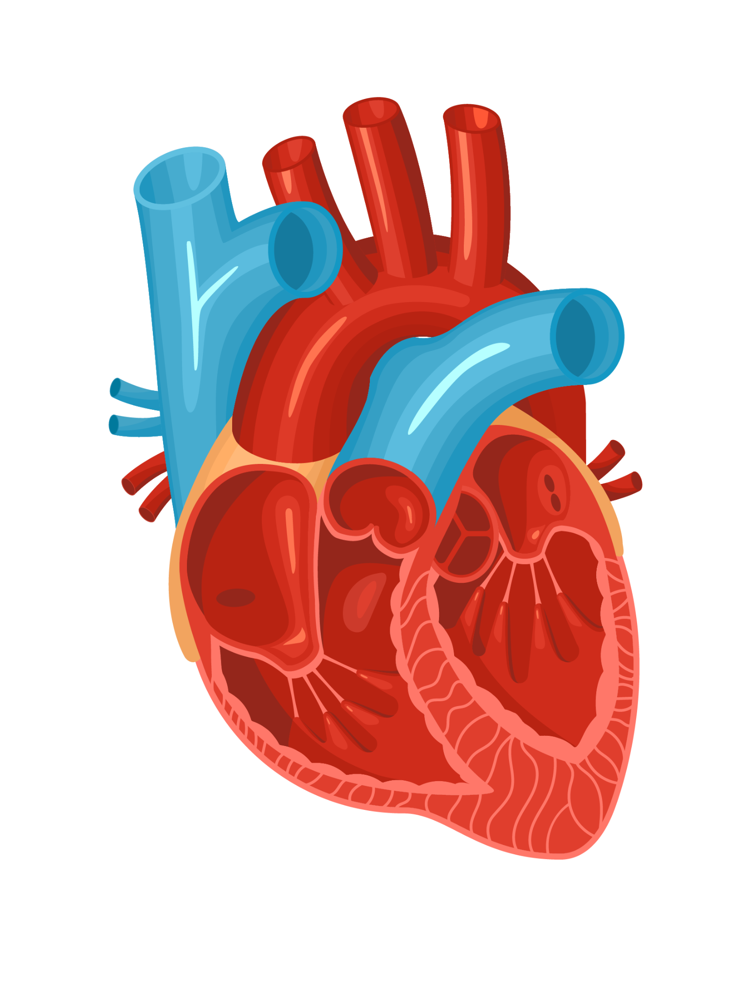
HEART ATTACK PREDICTION MACHINE LEARNING ANALYSIS
Presented By:
Group 6

Slide 2





TEAM MEMBERS
Kaspe Aravind Kumar
Rohith Lanka
Jyothirmai Kondepudi
Sai Teja Dugyala
Susmith Kumar Koripelli

Slide 3
TABLE OF CONTENTS
01
02
03
INTRODUCTION
DATA VISUALIZATION
FEATURE SELECTION
04
05
06
REGRESSION
DECISION TREE
KNN & NB
07
08
09
SVM GRAPHS
CONCLUSION
RANDOM FOREST & REGULARIZATION

Slide 4

—CARLY FIORINA
“The goal is to turn data into information, and information into insight.”

Slide 5

INTRODUCTION
In the realm of healthcare, where each heartbeat tells a unique story, we embark on a journey that merges cutting-edge technology with human well-being. Today, we delve into the realm of Heart Attack Prediction through the lens of Machine Learning – a pioneering approach that holds the promise of transforming the way we detect, prevent, and manage cardiovascular risks.

Slide 6

DATA DESCRIPTION
This dataset, compiled in 1988, comprises information from four distinct databases: Cleveland, Hungary, Switzerland, and Long Beach V. It encompasses 76 attributes. While it is extensive, this dataset has been predominantly utilized in published experiments focusing on a subset of 14 key features. The critical "target" field denotes the percentage of heart attack risk in patients.
In this presentation, we unravel the intricacies of heart attack prediction, exploring how machine learning tools can revolutionize risk assessment.
Dataset Link: https://www.kaggle.com/datasets/juledz/heart-attack-prediction/data

Slide 7
DATA ATTRIBUTES
Age: Numeric (e.g., 52) - The age of the patient.
Sex: Categorical (0: Female, 1: Male) - Gender of the patient.
Chest Pain Type: The type of chest pain reported by the patient.
Resting Blood Pressure: Numeric - The resting blood pressure of the patient.
Serum Cholesterol: Numeric in mg/dL (e.g., 212) - Serum cholesterol level in milligrams per deciliter.
Fasting Blood Sugar: Categorical (0: <= 120 mg/dL, 1: > 120 mg/dL) - Fasting blood sugar level.
Resting Electrocardiographic Results: Results of resting electrocardiogram.
Maximum Heart Rate Achieved: Numeric (e.g., 168) - The maximum heart rate achieved during the exercise.
Exercise-Induced Angina: Categorical (0: No, 1: Yes) - Presence or absence of exercise-induced angina.
Oldpeak (ST Depression): Numeric (e.g., 1.0) - ST depression induced by exercise relative to rest.
Slope of Peak Exercise ST Segment: Slope of the peak exercise ST segment.
Number of Major Vessels Colored by Fluoroscopy: Number of major vessels colored by fluoroscopy.
Thalassemia: Categorical (0: Normal, 1: Fixed Defect, 2: Reversible Defect) - Thalassemia category.

Slide 8
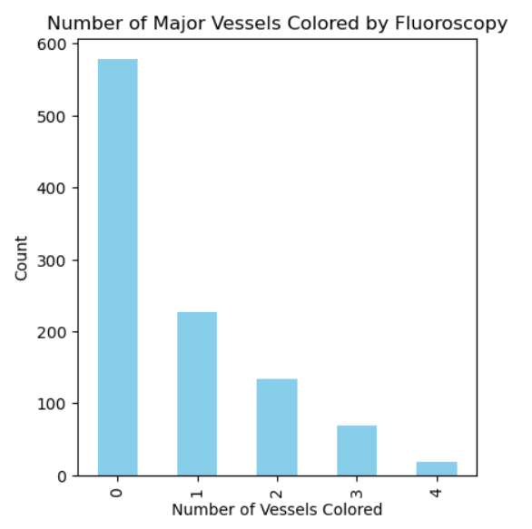
BAR GRAPH
The number of major vessels colored by Fluoroscopy is also called the number of vessels showing Coronary Artery Disease (CAD).
The x-axis represents the number of arteries that were blocked.
The y-axis represents the number of people who had (0-4) arteries blocked.
From the graph we can interpret that the people who had less number of arteries blocked possessed less risk of getting a heart attack.

Slide 9
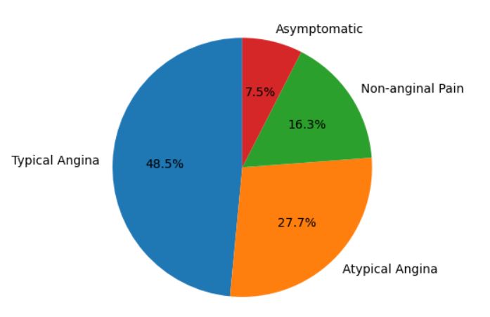
PIE CHART
The pie chart represents the percentage of people from the dataset with 4 different kinds of chest pain.
Typical Angina is the most common type of chest pain which was observed in 48.5% of the people who are seen to have a moderate to high risk of heart attack.
The most uncommon type of chest pain is asymptomatic with a percentage of 7.5%.
Non-anginal pain refers to symptoms that are not related to a heart attack but mimic one due to gastrointestinal issues etc.
Atypical angina does not fit the classic pattern of a heart attack but is caused due to an underlying CAD. 27.7% of patients experiencing this pain were a good target of a heart attack.

Slide 10
FEATURE SELECTION
Results of Methods:
Univariate Method: The selected features 'age', 'trestbps', 'chol’ and 'thalach' are deemed to be the most informative for the classification task, based on their respective scores calculated by the feature selection method.
RFE: The selected features 'age', 'trestbps', 'thalach', and 'oldpeak' are likely to be highly relevant for predicting the target variable.
Feature Importance: The selected features 'age', 'thalach', 'chol', and 'trestbps' are considered to be highly informative for predicting the target variable.
These features provide valuable information about the individual’s physiological characteristics and can significantly contribute to building a predictive model for the classifications.

Slide 11
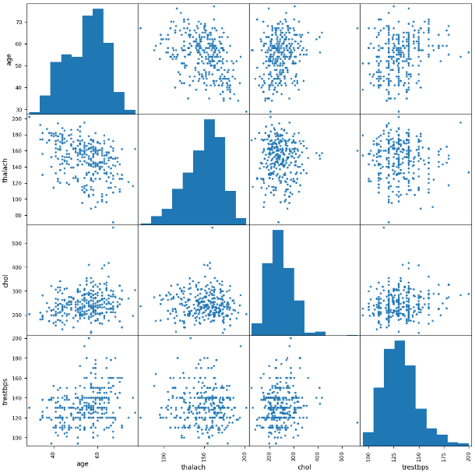
'age': Age is a fundamental demographic factor often correlated with various health conditions, making it a significant predictor in health-related classification tasks.
'thalach' (maximum heart rate achieved): Maximum heart rate achieved during exercise reflects cardiovascular fitness and health, with higher rates typically indicating better fitness levels.
'chol' (serum cholesterol levels): Serum cholesterol levels are crucial indicators of cardiovascular health, with elevated levels being associated with an increased risk of heart disease.
'trestbps' (resting blood pressure): Resting blood pressure is a key physiological parameter that correlates with cardiovascular health, with high blood pressure (hypertension) being a major risk factor for cardiovascular diseases.

Slide 12
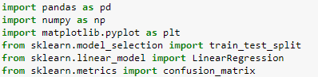
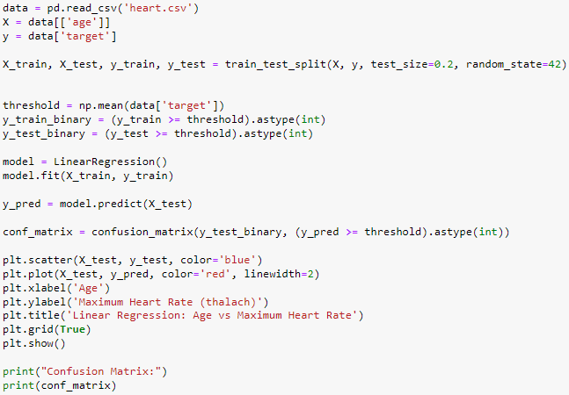
REGRESSION
Selected 'age' as the feature and 'Maximum Heart Rate' as the target variable.
Split the dataset into training and testing sets with a 20% test size, ensuring reproducibility with a fixed random state.
Binarize the target variable based on the mean value, categorizing values above the mean as positive instances and below as negative.
Train a linear regression model on the training data to predict the target variable.
Plot a scatter plot of test data points and the linear regression line, alongside a confusion matrix based on binarized predictions, to evaluate model performance.

Slide 13
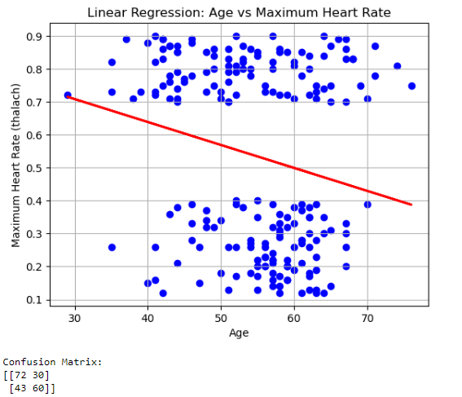
The model correctly predicted 72 instances of Maximum Heart Rate (TP).
There were 30 instances where the model predicted Maximum Heart Rate when it was not present (FP).
The model correctly predicted 43 instances of no Maximum Heart Rate (TN).
There were 60 instances where the model failed to predict Maximum Heart Rate when it was present (FN).
From confusion matrix data, we get insight into the performance of the model in classifying instances of Maximum Heart Rate. You can derive various evaluation metrics such as accuracy, precision, recall, and F1-score from this matrix to further assess the model's performance.

Slide 14
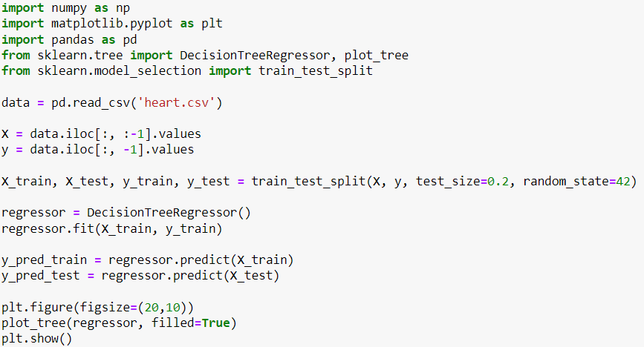
DECISION TREE
Separate the features (X) and the target variable (y) from the dataset.
Split the dataset into training and testing sets using train_test_split function from sklearn.model_selection module, with 80% of the data for training and 20% for testing.
Initialize a DecisionTreeRegressor model named 'regressor’. Train the regressor model using the training data (X_train, y_train) with the fit method.
Obtain predictions for both the training and testing data using predict method. Plot the decision tree using matplotlib's plot_tree function, with filled=True to color the nodes based on majority class, and display the tree using plt.show().

Slide 15
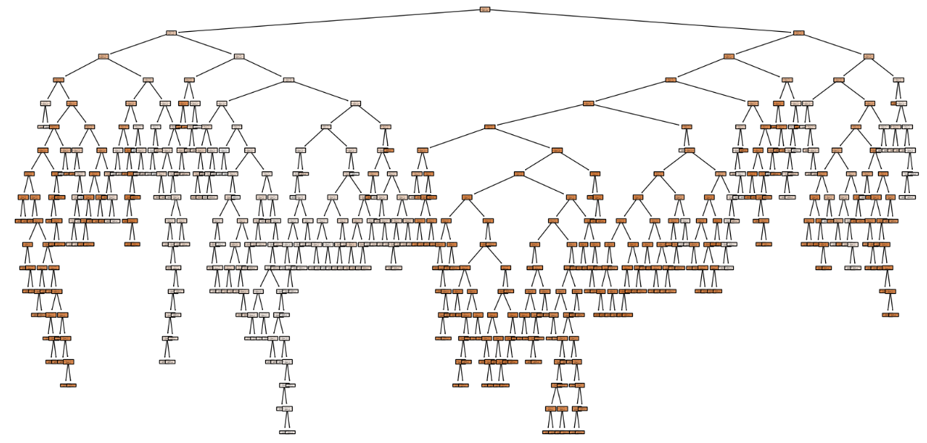
Nodes: Each node in the decision tree represents a decision point based on one of the features in the dataset. The root node represents the first decision point. Subsequent nodes are called internal nodes, and the final nodes are called leaf nodes.
Edges: The edges between nodes represent the decision paths taken by the algorithm based on the feature values. The edges leaving each node correspond to the possible outcomes of the decision.

Slide 16
Feature Split Criteria: At each internal node, the feature used for splitting the dataset is indicated along with the threshold value for the split. For example, in a node labeled "thal <= 2.5", the feature "thal" is used for splitting, and the threshold value is 2.5.
Samples: The number of samples that reach each node is displayed. This indicates the number of data points from the training set that satisfy the conditions necessary to reach that node.
Value: For regression problems, the predicted value at each node is displayed. This value represents the average target value of the samples that reach that node.

Slide 17
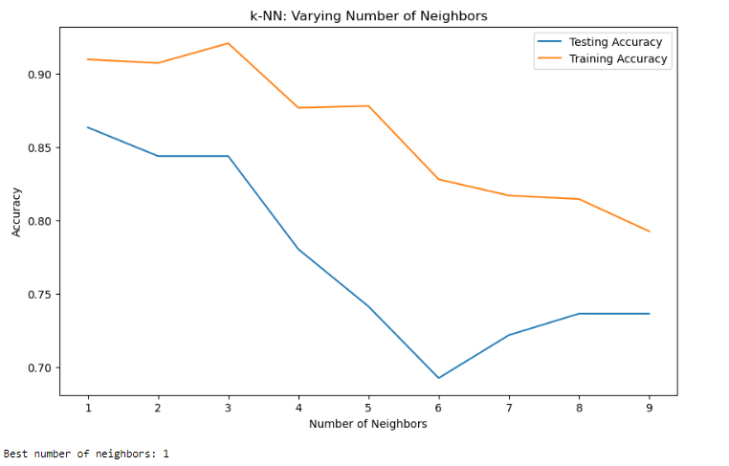
ELBOW GRAPH
The elbow graph for k-NN classification shows that the best performance on the test set occurs at k=1, suggesting potential overfitting as training accuracy is perfect at this point. As k increases, test accuracy decreases, and training accuracy drops, indicating the model is generalizing and possibly underfitting. A value of k that balances test accuracy with generalization would be ideal, but the graph suggests that the nearest neighbor approach is currently the most accurate for the dataset, which may indicate a need for further data preprocessing or feature selection to improve model performance for higher k values.

Slide 18
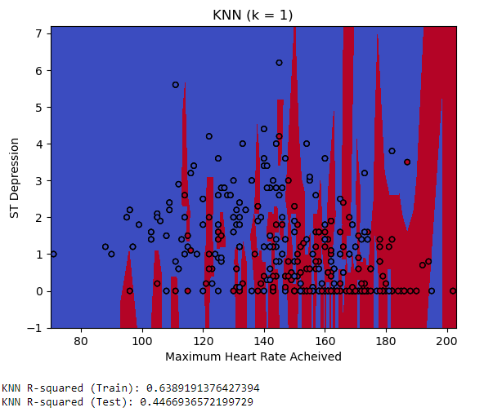
K - NEAREST NEIGHBOR
The graph depicts the KNN regression model's decision boundary with k=1, using 'Maximum Heart Rate Achieved' and 'ST Depression' as features. The red and blue areas represent different predicted values, with the data points overlaid as circles. The sharp division between colors indicates a model with high sensitivity to the training data, typical for k=1, which often leads to overfitting. This is supported by the R-squared values, which show that the model explains about 63.89% of the variance in the training set, but only about 44.67% in the test set, further suggesting overfitting to the training data.

Slide 19
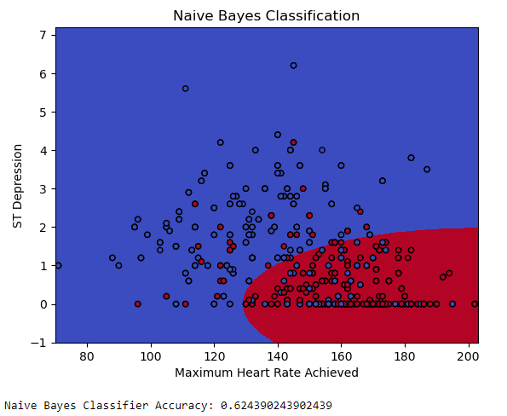
NAIVE BAYES
The Naive Bayes classification graph displays a decision boundary dividing points into two regions, likely corresponding to different classes. The boundary is relatively simple, reflecting Naive Bayes' assumption of feature independence. Data points are scattered across the feature space of 'Maximum Heart Rate Achieved' versus 'ST Depression', with some overlap at the boundary, indicating potential misclassification. The reported accuracy is approximately 62.43%, which suggests the model is moderately effective at classifying the data, though there may be room for improvement, perhaps through feature engineering or model tuning.

Slide 20
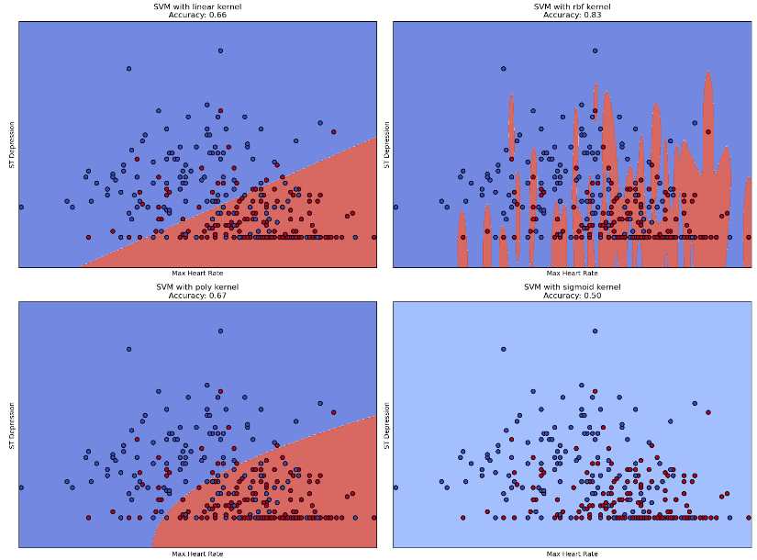
SVM
GRAPHS

Slide 21
SVM GRAPHS INTERPRETATION
The graphs of SVM decision boundaries with four types of kernels linear, RBF, polynomial, and sigmoid for the dataset with the highest heart rate and ST depression features exhibit different efficiency levels. Linear kernel gets an accuracy of 66% which implies its ability to classify is fairly weak and can identify classes with a linear boundary. It might encounter data that is nonlinearly separable. Substituting the RBF kernel raises accuracy to 83%, highlighting that the data is distributed non-linearly and that the non-linear RBF is perfect for capturing regions-based separation. The polynomial kernel has thus shown better performance than the linear model with an accuracy of 67% implying that considering the relationship between the variables has improved the classifier. On the other hand, the sigmoid kernel has the lowest performance at 50% accuracy which may suggest that the transformation it performs is not tailored to the structure of the data and thus performs as bad as a simple guessing at random. This comparison gives us an insight into the fact that kernel choice plays a key role in SVM classifiers, and the correct choice of kernel enhances performance by relatively better capturing data patterns.

Slide 22
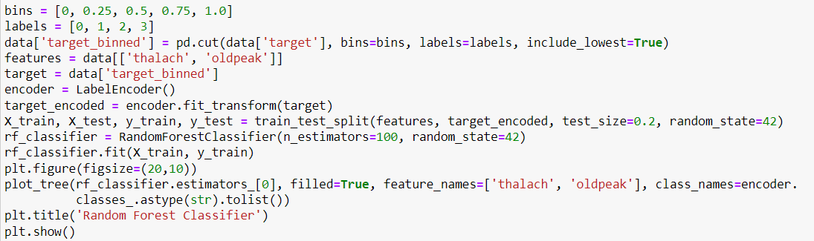
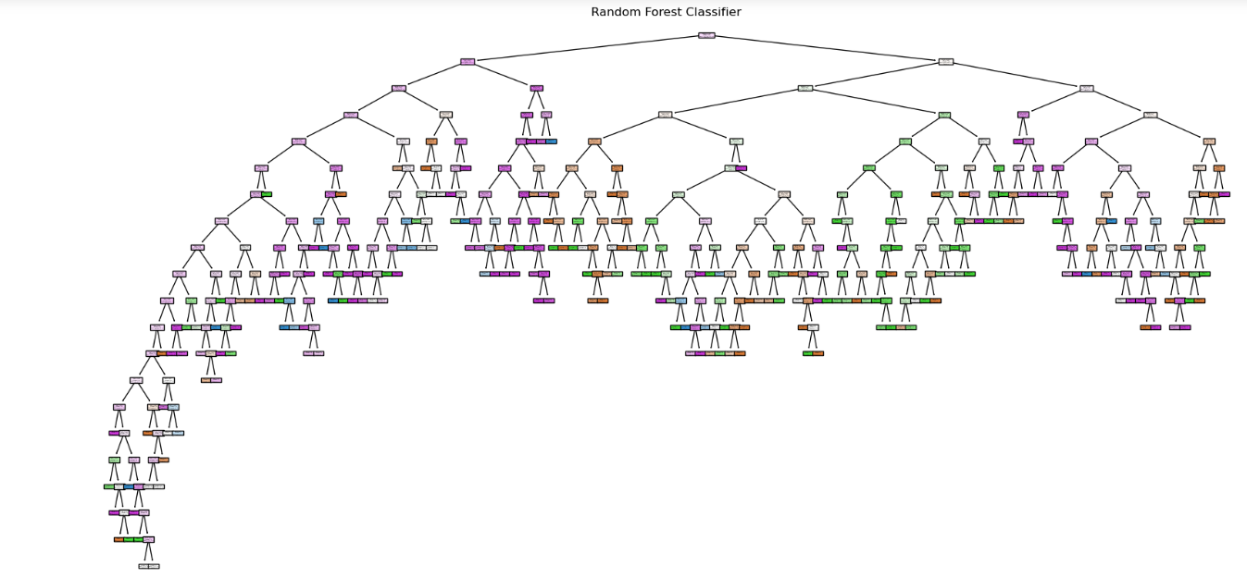
RANDOM FOREST CLASSIFER

Slide 23
Interpretation:
In the tree, each node represents a decision point where the data is split based on a threshold value of one of these features. The splits are made to segregate the samples into the target classes best. The leaves of the tree represent the final classifications. For example, a typical decision path might involve checking if `thalach` exceeds a certain value; if so, the path might then check if `oldpeak` falls below another threshold to determine the class.
The visualization provides insights into the hierarchical decision-making process of the tree, showing how different thresholds of heart rate and ST depression interact to predict different risk levels of heart disease. The depth and complexity of this tree indicate the tree's strategy in handling the diversity of cases, attempting to maximize accuracy by capturing nuanced patterns in the dataset. Each path from the root to a leaf represents a specific combination of feature conditions leading to a decision, illustrating the model's approach to sorting patients into different risk categories based on their physiological measurements.

Slide 24
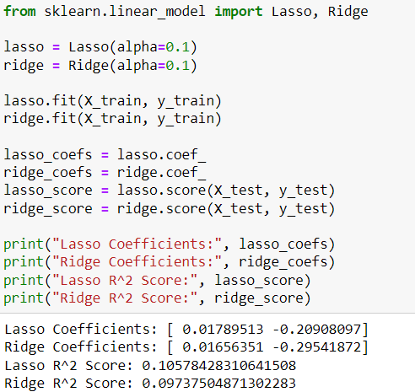
LASSO AND RIDGE
The Lasso and Ridge models applied to the dataset have yielded modestly different coefficients, suggesting varying degrees of correlation between the features and the target variable. Specifically, Lasso's coefficients [0.01789513, -0.20908097] indicate a positive influence of the first feature and a negative influence of the second on the target, with the model achieving an R² score of 0.1057. Similarly, Ridge regression reveals coefficients [0.01656531, -0.29541872] with a slightly lower R² score of 0.0937. These R² values suggest that both models explain a small fraction of the variability in the target and might be underfitting, which could imply that the linear models are too simplistic or the selected features do not capture the complexity of the dataset. Overall, while Lasso shows a marginal advantage over Ridge in this scenario, the performance of both models indicates a need for further refinement to improve predictive accuracy.

Slide 25
CONCLUSION
The conclusion would underscore the promise machine learning holds in the healthcare domain, particularly in preempting heart attack risks. The use of algorithms such as SVM and Random Forest exemplifies the nuanced approach necessary to interpret complex medical data effectively. The interpretation of the Random Forest model's graph affirms its capability to stratify heart disease risk based on physiological measurements. Additionally, the application of Lasso and Ridge regression reveals the intricate balance needed between feature selection and model complexity to avoid underfitting and improve predictive accuracy.
In closing, the presentation highlights the potential for improved diagnostic tools, emphasizing the need for continued research and refinement of models to enhance the accuracy and reliability of heart attack predictions. The end goal is to transform raw data into actionable insights that can save lives, aligning with the profound sentiment that technology, when aptly applied to human health, can produce meaningful advancements in disease prevention and management.

Slide 26
REFERENCES
1. Chandrasekhar, N.; Peddakrishna, S. Enhancing Heart Disease Prediction Accuracy through Machine Learning Techniques and Optimization. Processes 2023.
2. Bhatt, C.M.; Patel, P.; Ghetia, T.; Mazzeo, P.L. Effective Heart Disease Prediction Using Machine Learning Techniques. Algorithms 2023.
3. Subramani, S.; Varshney, N.; Anand, M.V. Cardiovascular Diseases Prediction by Machine Learning Incorporation with Deep Learning. Front. Med. 2023.
4. Jawalkar, A.P.; Swetcha, P.; Manasvi, N. Early Prediction of Heart Disease with Data Analysis Using Supervised Learning with Stochastic Gradient Boosting. SpringOne. 2023.

Slide 27
CONTRIBUTIONS
Kaspe Aravind Kumar: Aravind was pivotal in developing the project's codebase. His programming expertise facilitated the creation of robust machine-learning models and algorithms that are the backbone of heart attack prediction analysis.
Rohith Lanka: Rohith's proficiency in data visualization brought clarity and insight into the data. His ability to translate complex datasets into comprehensible visual formats was key in identifying patterns and trends that inform our predictions.
Jyothirmai Kondepudi: Jyothi excelled in interpreting the outcomes of our analyses. Her deep understanding of the data and the applied machine-learning techniques enabled her to provide clear, insightful interpretations of the models’ results.
Sai Teja Dugyala: Sai Teja, alongside Susmith, was instrumental in assembling the PowerPoint presentation. His attention to detail and design sense ensured that the information was presented in an accessible and engaging manner. Also, he played a key role in finalizing the dataset.
Susmith Kumar Koripelli: Susmith focused on the PowerPoint presentation's overall structure and narrative flow, ensuring that the progression of slides logically and effectively communicated the team's findings and analyses.

Slide 28


